Slide 1
Basics of Large Language Models (LLM)
Bhanu Chander V

Slide 2
LLM – What and How?
The Quick brown fox
The Quick brown fox jumps
The Quick brown fox jumps over . . .
Language Models: has the ability to predict the next word or sub-word (called tokens) based on the
text it has observed so far.
Runs (0.27)
Jumps (0.81)
Hides (0.63)
. . .
LMs - predicts one token at a time by assigning probabilities to tokens based on its training.
The token with the highest probability is used as the next part of the input.
This process is repeated continuously until a special stop token is selected.
Runs (0.27)
Jumps (0.81)
Hides (0.63)
. . .

Slide 3
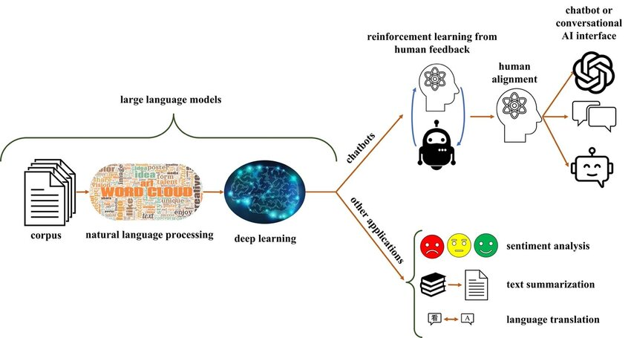
Applications
Applications:
Summarize
Data Extraction
NL Understand
NL Predict
NL Generate
Lang and Grammer
Translate
QA
Conversational
Sentiment A
Text Classify
Code completion
Corpus - Large volume of Internet Data (petabytes in size)
Common Crawl (open repository of web crawl data)
Wiki, Github, book corpus
source

Slide 4
What is ‘Large’ in LLM ?

Slide 5
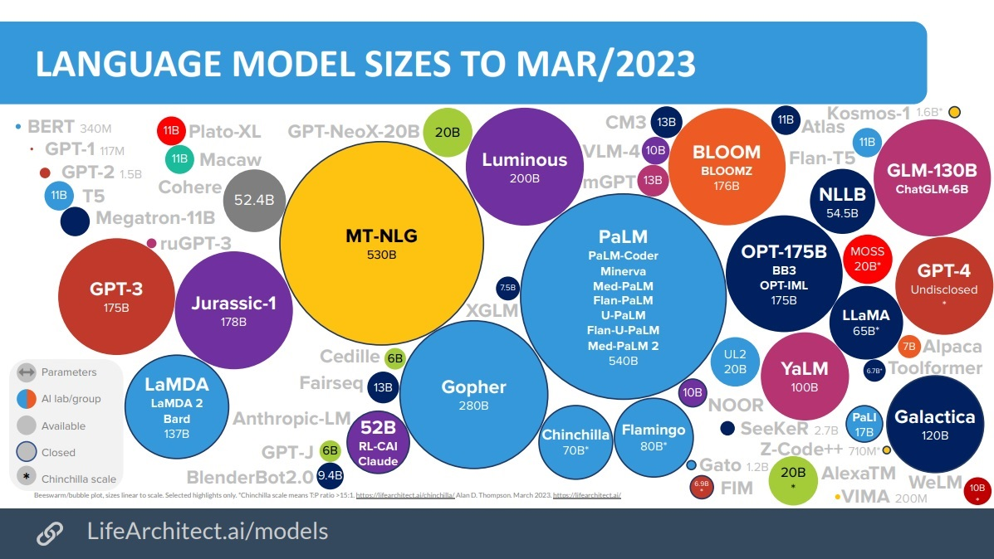

Slide 6
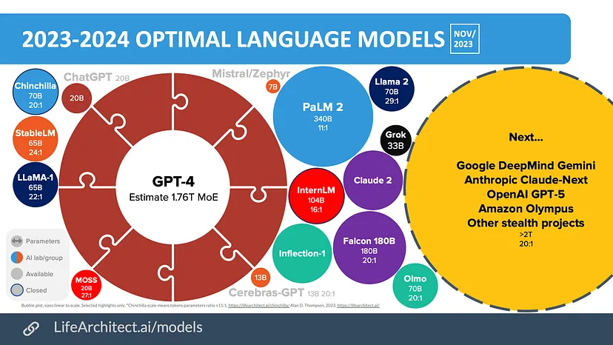

Slide 7
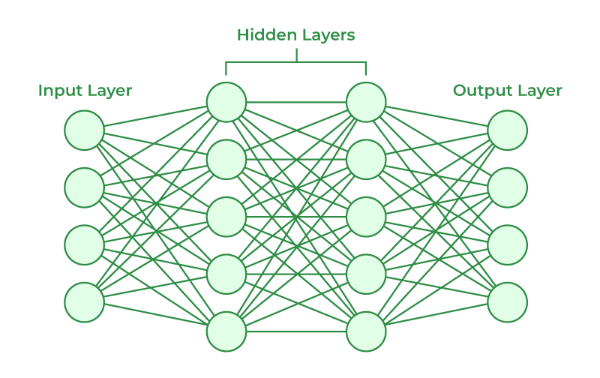
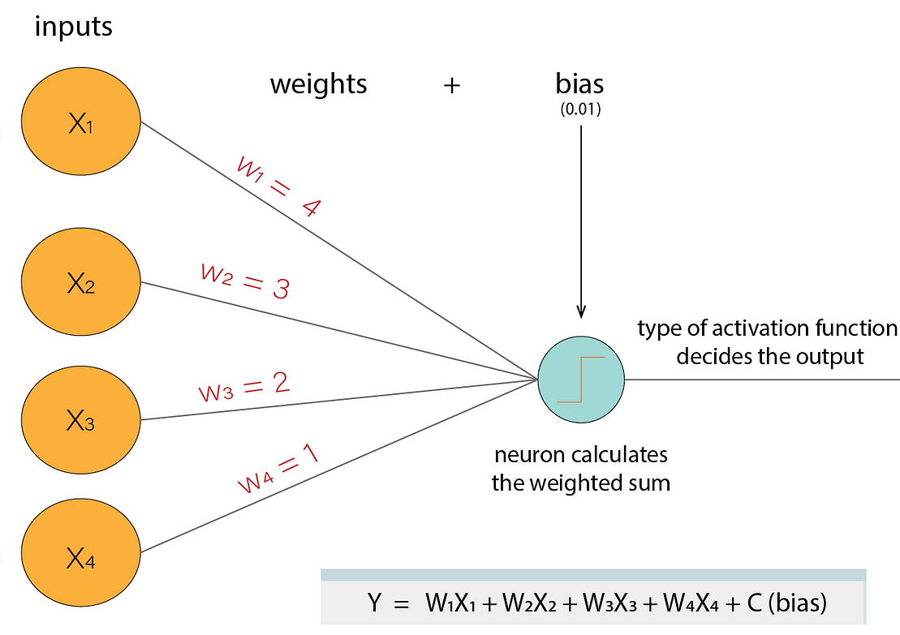
What is a parameter in Deep Learning
Sample Activation

Slide 8
Why LLMs ?
Where they fit?

Slide 9
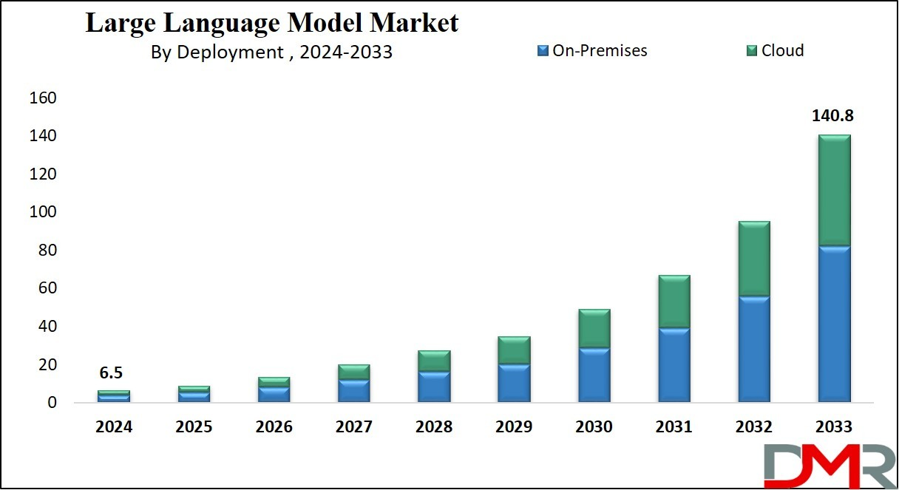
In million USD

Slide 10
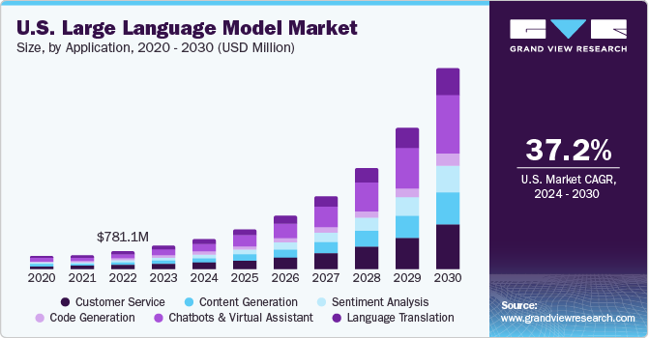

Slide 11
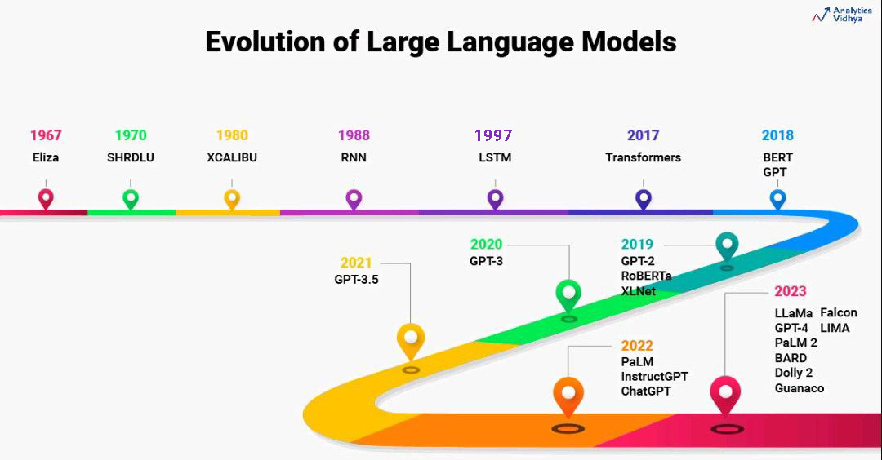

Slide 12
Transformers Vs RNNs and LSTM
RNN (Recurrent Neural Networks)
No attention mechanism – short-term dependency - remember only the short part of series
Process/understand one word at a time
Sequential - No parallel processing
Transformers:
Transformers can handle the whole input simultaneously, all at once (self-attention)
No Recurrent units but parallel processing (advantage)
Hence less training time
They can look at all the input and output words simultaneously and figure out how they’re related
LSTM (Long Short-Term Memory)
Use a hidden state to remember what happened in the past
Still, they can struggle to learn when there are too many layers
LSTM must remember all past observations (disadvantage)
source

Slide 13
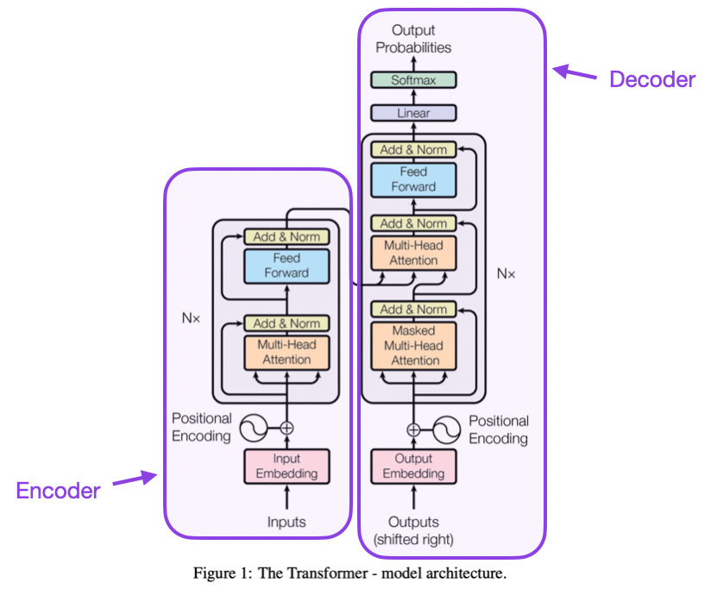
Transformers – The Brain behind LLM

Slide 14
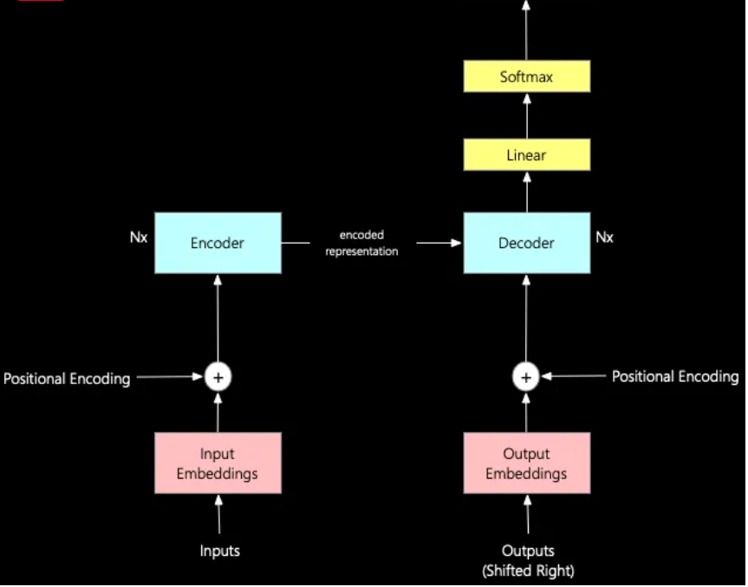

Slide 15
Tokens
Tokens
Sequences of characters found in a set of text.
The models learn to understand the statistical relationships between these tokens (using Chunking/Embedding)
Model excel at producing the next token in a sequence of tokens.
Tokenization
This process splits input text into tokens by breaking down the sentences and words.
Rule of thumb
100 tokens ~= 75 words
The API has a limit on the maximum number of input tokens for embeddings.
The newest embeddings model can handle inputs with up to 8191 input tokens
“I love LLMs” would be tokenized into [“I”, “love”, “LLMs”]

Slide 16
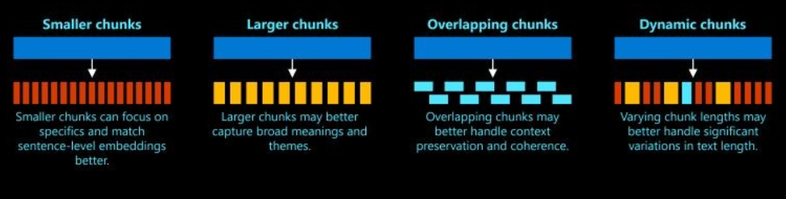
Chunking
Process of breaking down large text data into smaller, more manageable segments or chunks.
Extract important words or phrases from lengthy descriptions
Help us understand the structure of the sentence
identify parts of speech and short phrases (chunks) in a given sentence.
Example1:
“I had burgers and pastries for breakfast.”
Group or chunk noun phrases: “burgers”, “pastries” and “breakfast”
Example 2:
“The quick brown fox”
“the lazy dog”

Slide 17
Embeddings
Numeric representations of words
Captures semantic information.
Word embeddings convert words into numerical vectors.
Words with similar meanings will have similar vectors.
Word embeddings allow LLMs to capture these relationships in a mathematical way, enabling them to generate text that is semantically similar to the training data.
[1.23, 0.21, 0.76,……]
Example:
Similar Vectors
“King” and “Man”
“Queen” and “Woman”.
Example:
Closer Vectors: “fox” and “dog”
Not closer vectors: “fox” and “jumps”.

Slide 18
Additional Information:
OpenAI’s API can generate embeddings for texts
OpenAI’s API currently does not provide a built-in functionality for similarity search using embeddings.
You would need to implement the similarity search functionality yourself.
FAISS is a great choice for this purpose. It’s a library specifically designed for efficient similarity search of dense vectors, like the embeddings generated by OpenAI’s API.

Slide 19
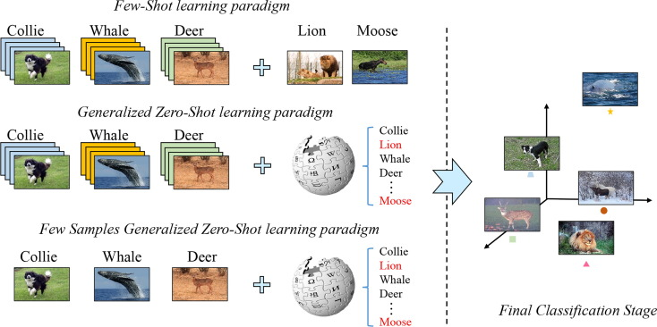
Common Learning Models
Zero-shot learning
Base LLMs can respond to a broad range of requests without explicit training, often through prompts, although answer accuracy varies.
Few-shot learning
By providing a few relevant training examples, base model performance significantly improves in that specific area.
Fine-tuning
Extension of few-shot learning –
Train a base model to adjust its parameters with additional data relevant to the specific application.

Slide 20
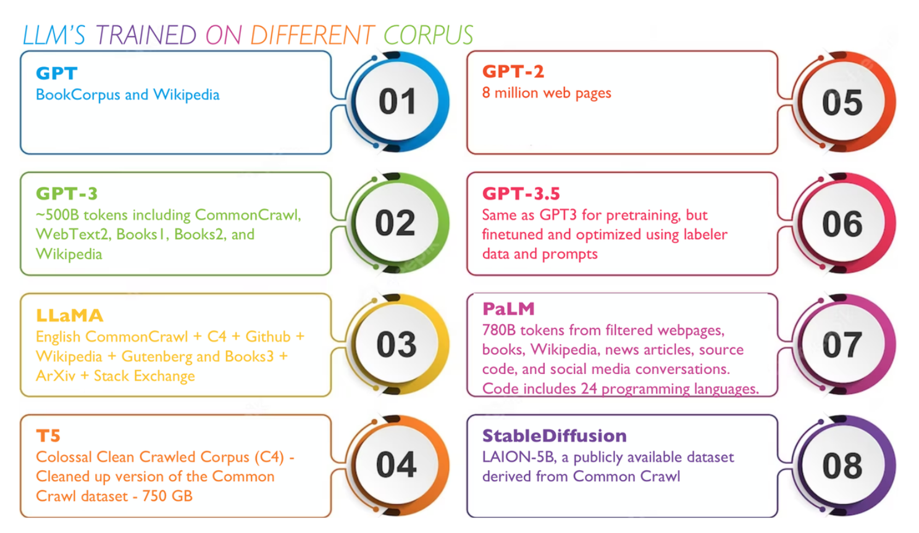

Slide 21
Transformers Explained
Inputs and Input Embeddings
Create Embeddings for Input data
2. Input/Positional Encoding:
The order of words in a sentence is crucial for determining
the sentence’s meaning
Positional encoding can be used to encode the position of
each word in the input sequence as a set of numbers.
These numbers can be fed into the Transformer model, along with the input embeddings.
Encoder
Processes the input text and generates a series of hidden states
Hidden states captures the meaning and context of the text.
Multiple layers of the encoder are used in the transformer.
4. Output and Output Embeddings
Create embeddings for output data
Output embeddings are similar to input embeddings and go through positional encoding, which helps the model understand the order of words in a sentence.
source

Slide 22
Transformers Explained
5. Decoder
The positionally encoded input representation and the
positionally encoded output embeddings go through the
decoder.
Decoder generates the output sequence based on the
encoded input sequence (it learns during training)
6. Linear Layer and Softmax
The linear layer maps output embedding into to a
higher-dimensional space
This step is necessary to transform the output embeddings into the original input space.
Softmax function generates output tokens with probabilities
source

Slide 23
Further study
10.pdf (stanford.edu)
[1706.03762] Attention Is All You Need (arxiv.org)

Slide 24
Input Encoding: The input text is converted into numerical representations, known as embeddings.
Self-Attention: The Transformer calculates a score for each word in the sentence, indicating how much attention should be paid to that word when predicting the next word. This is done for every word in the sentence, allowing each word to have a global understanding of the entire sentence.
Aggregation: The Transformer aggregates the attention scores and the corresponding word embeddings to produce a new representation for each word. This new representation is a weighted sum of all word embeddings in the sentence, with the weights determined by the attention scores.
Output Generation: The Transformer uses the aggregated representations to generate the output1. This could be the next word in a sentence for text generation tasks, or a classification label for text classification tasks1.
source

